Slide 1
18-447 Computer Architecture Lecture 32: Heterogeneous Systems
Prof. Onur Mutlu
Carnegie Mellon University
Spring 2014, 4/20/2015

Slide 2
Where We Are in Lecture Schedule
The memory hierarchy
Caches, caches, more caches
Virtualizing the memory hierarchy: Virtual Memory
Main memory: DRAM
Main memory control, scheduling
Memory latency tolerance techniques
Non-volatile memory
Multiprocessors
Coherence and consistency
In-memory computation and predictable performance
Multi-core issues (e.g., heterogeneous multi-core)
Interconnection networks

Slide 3
First, Some Administrative Things

Slide 4
Midterm II and Midterm II Review
Midterm II is this Friday (April 24, 2015)
12:30-2:30pm, CIC Panther Hollow Room (4th floor)
Please arrive 5 minutes early and sit with 1-seat separation
Same rules as Midterm I except you get to have 2 cheat sheets
Covers all topics we have examined so far, with more focus on Lectures 17-32 (Memory Hierarchy and Multiprocessors)
Midterm II Review is Wednesday (April 22)
Come prepared with questions on concepts and lectures
Detailed homework and exam questions and solutions → study on your own and ask TAs during office hours

Slide 5
Suggestions for Midterm II
Solve past midterms (and finals) on your own…
And, check your solutions vs. the online solutions
Questions will be similar in spirit
http://www.ece.cmu.edu/~ece447/s15/doku.php?id=exams
Do Homework 7 and go over past homeworks.
Study and internalize the lecture material well.
Buzzwords can help you. Ditto for slides and videos.
Understand how to solve all homework & exam questions.
Study hard.
Also read: https://piazza.com/class/i3540xiz8ku40a?cid=335

Slide 6
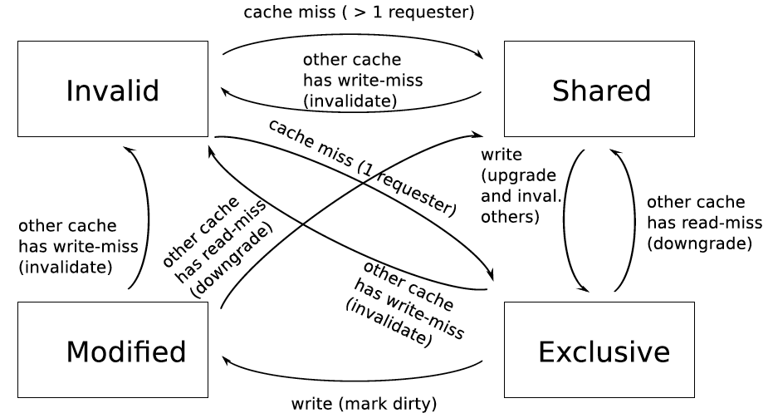
Lab 8: Multi-Core Cache Coherence
Due May 3; Last submission accepted on May 10, 11:59pm
Cycle-level modeling of the MESI cache coherence protocol
Since this is the last lab
An automatic extension of 7 days granted for everyone
No other late days accepted

Slide 7
Reminder on Collaboration on 447 Labs
Reminder of 447 policy:
Absolutely no form of collaboration allowed
No discussions, no code sharing, no code reviews with fellow students, no brainstorming, …
All labs and all portions of each lab has to be your own work
Just focus on doing the lab yourself, alone

Slide 8
We Have Another Course for Collaboration
740 is the next course in sequence
Tentative Time: Lect. MW 7:30-9:20pm, (Rect. T 7:30pm)
Content:
Lectures: More advanced, with a different perspective
Recitations: Delving deeper into papers, advanced topics
Readings: Many fundamental and research readings; will do many reviews
Project: More open ended research project. Proposal → milestones → final poster and presentation
Done in groups of 1-3
Focus of the course is the project (and papers)
Exams: lighter and fewer
Homeworks: None

Slide 9
A Note on Testing Your Own Code
We provide the reference simulator to aid you
Do not expect it to be given, and do not rely on it much
In real life, there are no reference simulators
The architect designs the reference simulator
The architect verifies it
The architect tests it
The architect fixes it
The architect makes sure there are no bugs
The architect ensures the simulator matches the specification

Slide 10
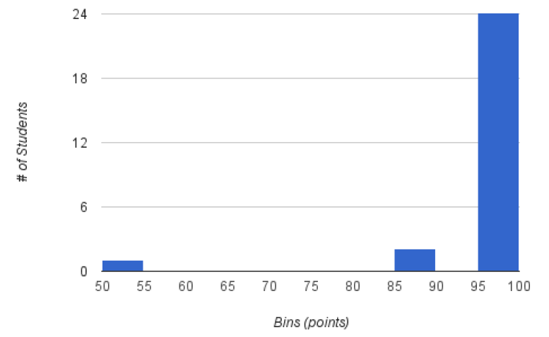
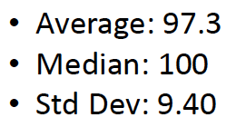
Lab 6 Grade Distribution

Slide 11
Lab 6 Extra Credit Recognitions
Stay tuned…

Slide 12
Lab 4-5 Special Recognition
Limited out-of-order execution
Terence An

Slide 13
Where We Are in Lecture Schedule
The memory hierarchy
Caches, caches, more caches
Virtualizing the memory hierarchy: Virtual Memory
Main memory: DRAM
Main memory control, scheduling
Memory latency tolerance techniques
Non-volatile memory
Multiprocessors
Coherence and consistency
In-memory computation and predictable performance
Multi-core issues (e.g., heterogeneous multi-core)
Interconnection networks

Slide 14
Today
Heterogeneity (asymmetry) in system design
Evolution of multi-core systems
Handling serial and parallel bottlenecks better
Heterogeneous multi-core systems

Slide 15
Heterogeneity (Asymmetry)

Slide 16
Heterogeneity (Asymmetry) → Specialization
Heterogeneity and asymmetry have the same meaning
Contrast with homogeneity and symmetry
Heterogeneity is a very general system design concept (and life concept, as well)
Idea: Instead of having multiple instances of the same “resource” to be the same (i.e., homogeneous or symmetric), design some instances to be different (i.e., heterogeneous or asymmetric)
Different instances can be optimized to be more efficient in executing different types of workloads or satisfying different requirements/goals
Heterogeneity enables specialization/customization

Slide 17
Why Asymmetry in Design? (I)
Different workloads executing in a system can have different behavior
Different applications can have different behavior
Different execution phases of an application can have different behavior
The same application executing at different times can have different behavior (due to input set changes and dynamic events)
E.g., locality, predictability of branches, instruction-level parallelism, data dependencies, serial fraction, bottlenecks in parallel portion, interference characteristics, …
Systems are designed to satisfy different metrics at the same time
There is almost never a single goal in design, depending on design point
E.g., Performance, energy efficiency, fairness, predictability, reliability, availability, cost, memory capacity, latency, bandwidth, …

Slide 18
Why Asymmetry in Design? (II)
Problem: Symmetric design is one-size-fits-all
It tries to fit a single-size design to all workloads and metrics
It is very difficult to come up with a single design
that satisfies all workloads even for a single metric
that satisfies all design metrics at the same time
This holds true for different system components, or resources
Cores, caches, memory, controllers, interconnect, disks, servers, …
Algorithms, policies, …

Slide 19
Asymmetry Enables Customization
Symmetric: One size fits all
Energy and performance suboptimal for different “workload” behaviors
Asymmetric: Enables customization and adaptation
Processing requirements vary across workloads (applications and phases)
Execute code on best-fit resources (minimal energy, adequate perf.)
C
C
C
C
C1
C2
C
C
C
C
C3
C
C
C
C
C4
C4
C4
C4
C
C
C
C
C5
C5
C5
C5
Symmetric
Asymmetric

Slide 20
We Have Already Seen Examples Before (in 447)
CRAY-1 design: scalar + vector pipelines
Modern processors: scalar instructions + SIMD extensions
Decoupled Access Execute: access + execute processors
Thread Cluster Memory Scheduling: different memory scheduling policies for different thread clusters
RAIDR: Heterogeneous refresh rate
Hybrid memory systems
DRAM + Phase Change Memory
Fast, Costly DRAM + Slow, Cheap DRAM
Reliable, Costly DRAM + Unreliable, Cheap DRAM
…

Slide 21
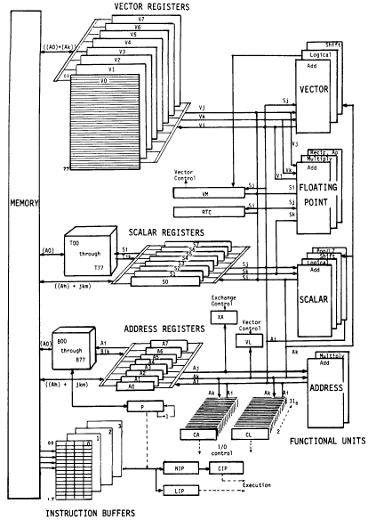
An Example Asymmetric Design: CRAY-1
CRAY-1
Russell, “The CRAY-1 computer system,” CACM 1978.
Scalar and vector modes
8 64-element vector registers
64 bits per element
16 memory banks
8 64-bit scalar registers
8 24-bit address registers

Slide 22
Remember: Hybrid Memory Systems
CPU
Meza+, “Enabling Efficient and Scalable Hybrid Memories,” IEEE Comp. Arch. Letters, 2012.
Yoon, Meza et al., “Row Buffer Locality Aware Caching Policies for Hybrid Memories,” ICCD 2012 Best Paper Award.
DRAMCtrl
PCM Ctrl
DRAM
Phase Change Memory (or Tech. X)
Fast, durable
Small,
leaky, volatile,
high-cost
Large, non-volatile, low-cost
Slow, wears out, high active energy
Hardware/software manage data allocation and movement
to achieve the best of multiple technologies

Slide 23
Remember: Throughput vs. Fairness
Throughput biased approach
Fairness biased approach
Prioritize less memory-intensive threads
Take turns accessing memory
Good for throughput
Does not starve
thread A
less memory intensive
thread B
higher
priority
thread C
thread A
thread B
thread C
not prioritized ➔
reduced throughput
starvation ➔ unfairness
Single policy for all threads is insufficient
Notes:
So why do previous algorithms fail?
On the one hand there is the throughput biased approach that prioritizes less memory-intensive threads.
Servicing memory requests from such threads allow them to make progress in the processor, increasing throughput.
However, the most memory-intensive thread, thread C, remains persistently deprioritized and and becomes prone to starvation causing large slowdowns and, ultimately, unfairness.
On the other hand there is the fairness biased approach where threads take turns accessing the memory.
In this case, the most memory-intensive thread does not starve.
However, the least memory-intensive thread, thread A, is not prioritized, leading to reduced throughput.
As you can see, a single policy applied to all threads is insufficient since different threads have different memory access needs.

Slide 24

Remember: Achieving the Best of Both Worlds
higher
priority
For Throughput
Prioritize memory-non-intensive threads
thread
thread
thread
For Fairness
thread
Unfairness caused by memory-intensive being prioritized over each other
Shuffle thread ranking
Memory-intensive threads have different vulnerability to interference
Shuffle asymmetrically
thread
thread
thread
thread
thread
thread
thread
thread
Notes:
So how do we achieve the best of both worlds? Our algorithm is based on the following insights:
First, we would like to prioritize the memory-non-intensive threads to increase system throughput.
Doing so does not degrade unfairness, since memory-non-intensive threads are inherently “light” and rarely cause interference for the memory-intensive threads.
For fairness, we discovered that unfairness is usually caused when one memory-intensive thread is prioritized over another.
As we’ve seen, the most deprioritized thread can starve.
To address this problem, we would like to shuffle their priority so that no single thread is persistently prioritized over another thread.
However, memory-intensive threads are not created equal.
They have different vulnerability to memory interference.
To address their differences, shuffling should be performed in an asymmetric manner.

Slide 25
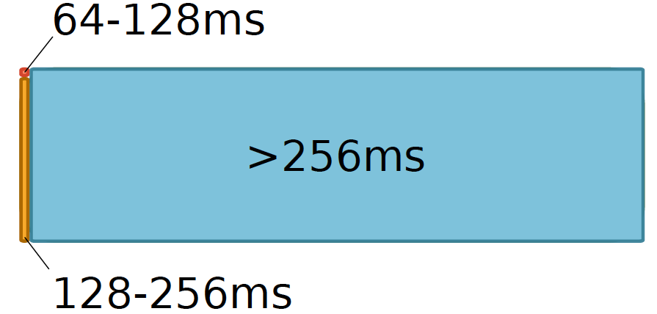
Remember: Heterogeneous Retention Times in DRAM

Slide 26
Aside: Examples from Life
Heterogeneity is abundant in life
both in nature and human-made components
Humans are heterogeneous
Cells are heterogeneous → specialized for different tasks
Organs are heterogeneous
Cars are heterogeneous
Buildings are heterogeneous
Rooms are heterogeneous
…

Slide 27
General-Purpose vs. Special-Purpose
Asymmetry is a way of enabling specialization
It bridges the gap between purely general purpose and purely special purpose
Purely general purpose: Single design for every workload or metric
Purely special purpose: Single design per workload or metric
Asymmetric: Multiple sub-designs optimized for sets of workloads/metrics and glued together
The goal of a good asymmetric design is to get the best of both general purpose and special purpose

Slide 28
Asymmetry Advantages and Disadvantages
Advantages over Symmetric Design
+ Can enable optimization of multiple metrics
+ Can enable better adaptation to workload behavior
+ Can provide special-purpose benefits with general-purpose usability/flexibility
Disadvantages over Symmetric Design
- Higher overhead and more complexity in design, verification
- Higher overhead in management: scheduling onto asymmetric components
- Overhead in switching between multiple components can lead to degradation

Slide 29
Yet Another Example
Modern processors integrate general purpose cores and GPUs
CPU-GPU systems
Heterogeneity in execution models

Slide 30
Three Key Problems in Future Systems
Memory system
Applications are increasingly data intensive
Data storage and movement limits performance & efficiency
Efficiency (performance and energy) → scalability
Enables scalable systems → new applications
Enables better user experience → new usage models
Predictability and robustness
Resource sharing and unreliable hardware causes QoS issues
Predictable performance and QoS are first class constraints
Asymmetric Designs
Can Help Solve These Problems

Slide 31
Multi-Core Design

Slide 32
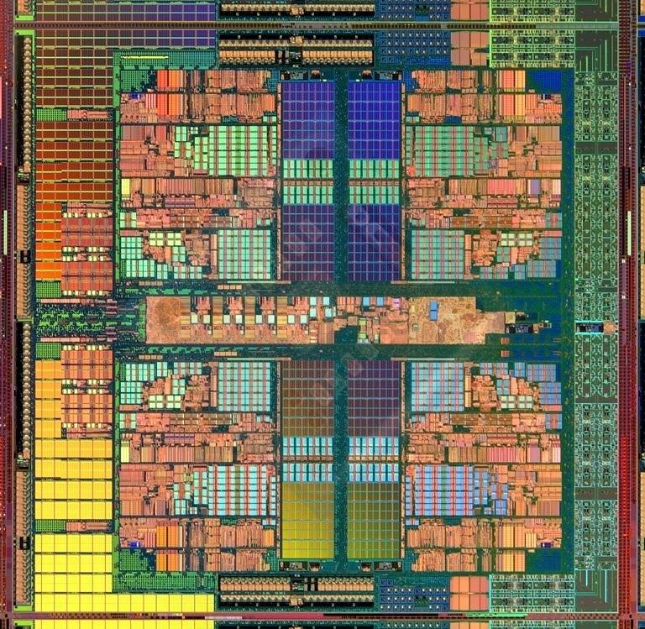
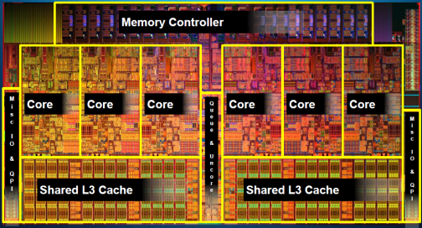
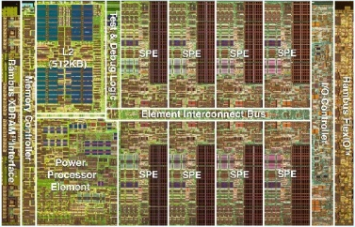
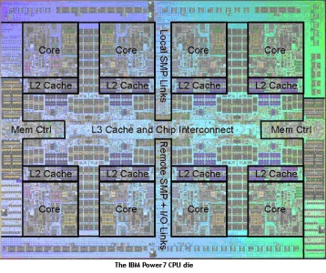
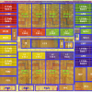
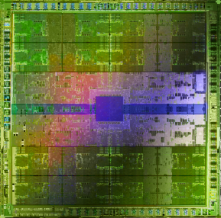
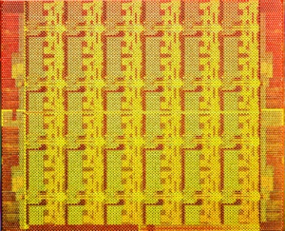
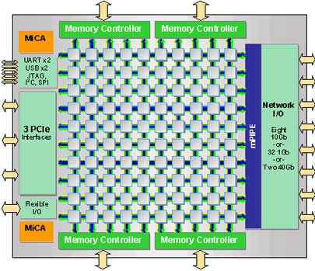
Many Cores on Chip
Simpler and lower power than a single large core
Large scale parallelism on chip
Intel Core i7 8 cores
IBM Cell BE 8+1 cores
IBM POWER7
8 cores
AMD Barcelona
4 cores
Nvidia Fermi
448 “cores”
Intel SCC
48 cores, networked
Tilera TILE Gx
100 cores, networked
Sun Niagara II
8 cores

Slide 33
With Many Cores on Chip
What we want:
N times the performance with N times the cores when we parallelize an application on N cores
What we get:
Amdahl’s Law (serial bottleneck)
Bottlenecks in the parallel portion

Slide 34
Caveats of Parallelism
Amdahl’s Law
f: Parallelizable fraction of a program
N: Number of processors
Amdahl, “Validity of the single processor approach to achieving large scale computing capabilities,” AFIPS 1967.
Maximum speedup limited by serial portion: Serial bottleneck
Parallel portion is usually not perfectly parallel
Synchronization overhead (e.g., updates to shared data)
Load imbalance overhead (imperfect parallelization)
Resource sharing overhead (contention among N processors)
1
Speedup =
1 - f
+
f
N

Slide 35
The Problem: Serialized Code Sections
Many parallel programs cannot be parallelized completely
Causes of serialized code sections
Sequential portions (Amdahl’s “serial part”)
Critical sections
Barriers
Limiter stages in pipelined programs
Serialized code sections
Reduce performance
Limit scalability
Waste energy

Slide 36
Example from MySQL
Asymmetric
Critical Section
Access Open Tables Cache
Open database tables
Speedup
Today
Perform the operations
….
Parallel
Chip Area (cores)
Notes:
I show an example from the MySQL database. Each database thread first>>>
opens the database tables it requires, and >>>
then processes the transaction >>>
While independent transactions can proceed in parallel, opening the tables requires accessing a shared data structure called the Open Table Caches. The open tables cache is a 2-dimensional a linked data structure accesses to which are difficult to parallelize. >>>
Thus the accesses are encapsulated in a critical section.>>>

Slide 37
Demands in Different Code Sections
What we want:
In a serialized code section → one powerful “large” core
In a parallel code section → many wimpy “small” cores
These two conflict with each other:
If you have a single powerful core, you cannot have many cores
A small core is much more energy and area efficient than a large core

Slide 38
“Large” vs. “Small” Cores
Large Core
Small Core
Out-of-order
Wide fetch e.g. 4-wide
Deeper pipeline
Aggressive branch predictor (e.g. hybrid)
Multiple functional units
Trace cache
Memory dependence speculation
In-order
Narrow Fetch e.g. 2-wide
Shallow pipeline
Simple branch predictor (e.g. Gshare)
Few functional units
Large Cores are power inefficient: e.g., 2x performance for 4x area (power)

Slide 39
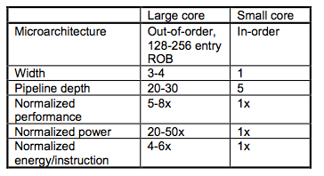
Large vs. Small Cores
Grochowski et al., “Best of both Latency and Throughput,” ICCD 2004.

Slide 40
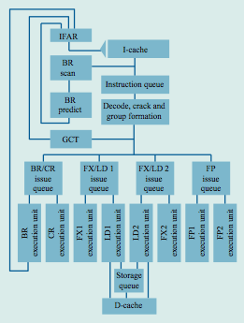
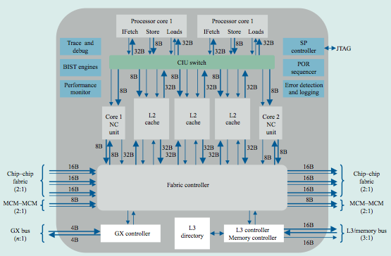
Meet Large: IBM POWER4
Tendler et al., “POWER4 system microarchitecture,” IBM J R&D, 2002.
A symmetric multi-core chip…
Two powerful cores

Slide 41
IBM POWER4
2 cores, out-of-order execution
100-entry instruction window in each core
8-wide instruction fetch, issue, execute
Large, local+global hybrid branch predictor
1.5MB, 8-way L2 cache
Aggressive stream based prefetching

Slide 42
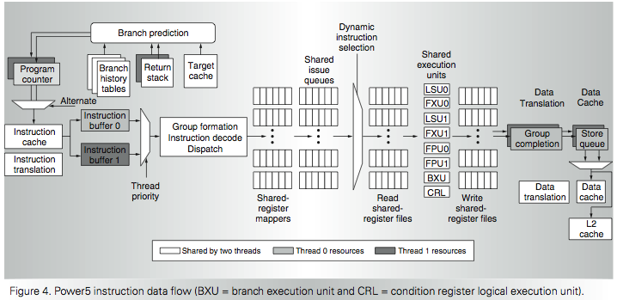
IBM POWER5
Kalla et al., “IBM Power5 Chip: A Dual-Core Multithreaded Processor,” IEEE Micro 2004.

Slide 43
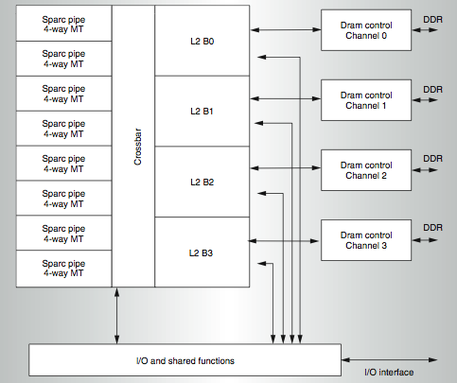
Meet Small: Sun Niagara (UltraSPARC T1)
Kongetira et al., “Niagara: A 32-Way Multithreaded SPARC Processor,” IEEE Micro 2005.

Slide 44
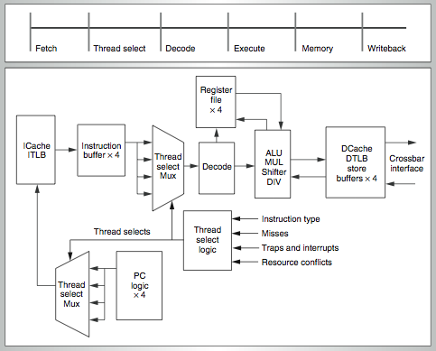
Niagara Core
4-way fine-grain multithreaded, 6-stage, dual-issue in-order
Round robin thread selection (unless cache miss)
Shared FP unit among cores

Slide 45
Remember the Demands
What we want:
In a serialized code section → one powerful “large” core
In a parallel code section → many wimpy “small” cores
These two conflict with each other:
If you have a single powerful core, you cannot have many cores
A small core is much more energy and area efficient than a large core
Can we get the best of both worlds?

Slide 46
Performance vs. Parallelism
Assumptions:
1. Small cores takes an area budget of 1 and has performance of 1
2. Large core takes an area budget of 4 and has performance of 2

Slide 47
Tile-Large Approach
Tile a few large cores
IBM Power 5, AMD Barcelona, Intel Core2Quad, Intel Nehalem
+ High performance on single thread, serial code sections (2 units)
- Low throughput on parallel program portions (8 units)
Large
core
Large core
Large core
Large core
“Tile-Large”

Slide 48
Tile-Small Approach
Tile many small cores
Sun Niagara, Intel Larrabee, Tilera TILE (tile ultra-small)
+ High throughput on the parallel part (16 units)
- Low performance on the serial part, single thread (1 unit)
Small core
Small core
Small core
Small core
Small core
Small core
Small core
Small core
Small core
Small core
Small core
Small core
Small core
Small core
Small core
Small core
“Tile-Small”

Slide 49
Can we get the best of both worlds?
Tile Large
+ High performance on single thread, serial code sections (2 units)
- Low throughput on parallel program portions (8 units)
Tile Small
+ High throughput on the parallel part (16 units)
- Low performance on the serial part, single thread (1 unit), reduced single-thread performance compared to existing single thread processors
Idea: Have both large and small on the same chip → Performance asymmetry

Slide 50
Asymmetric Multi-Core

Slide 51
Asymmetric Chip Multiprocessor (ACMP)
Provide one large core and many small cores
+ Accelerate serial part using the large core (2 units)
+ Execute parallel part on small cores and large core for high throughput (12+2 units)
Large
core
Large core
Small core
Small core
Small core
Small core
Large
core
Small core
Small core
Small core
Small core
Small core
Small core
Small core
Small core
Large core
Large core
Small core
Small core
Small core
Small core
Small core
Small core
Small core
Small core
Small core
Small core
Small core
Small core
Small core
Small core
Small core
Small core
“Tile-Large”
“Tile-Small”
ACMP

Slide 52
Accelerating Serial Bottlenecks
Single thread → Large core
Large
core
Small core
Small core
Small core
Small core
Small core
Small core
Small core
Small core
Small core
Small core
Small core
Small core
ACMP Approach

Slide 53
Performance vs. Parallelism
Assumptions:
1. Small cores takes an area budget of 1 and has performance of 1
2. Large core takes an area budget of 4 and has performance of 2

Slide 54
ACMP Performance vs. Parallelism
Area-budget = 16 small cores
Large
core
Large core
Small core
Small core
Small core
Small core
Large
core
Small core
Small core
Small core
Small core
Small core
Small core
Small core
Small core
Large core
Large core
Small core
Small core
Small core
Small core
Small core
Small core
Small core
Small core
Small core
Small core
Small core
Small core
Small core
Small core
Small core
Small core
“Tile-Large”
“Tile-Small”
ACMP
Large Cores | 4 | 0 | 1
Small Cores | 0 | 16 | 12
Serial Performance | 2 | 1 | 2
Parallel Throughput | 2 x 4 = 8 | 1 x 16 = 16 | 1x2 + 1x12 = 14
54

Slide 55
Amdahl’s Law Modified
Simplified Amdahl’s Law for an Asymmetric Multiprocessor
Assumptions:
Serial portion executed on the large core
Parallel portion executed on both small cores and large cores
f: Parallelizable fraction of a program
L: Number of large processors
S: Number of small processors
X: Speedup of a large processor over a small one
1
Speedup =
1 - f
+
f
X
S + X*L

Slide 56
Caveats of Parallelism, Revisited
Amdahl’s Law
f: Parallelizable fraction of a program
N: Number of processors
Amdahl, “Validity of the single processor approach to achieving large scale computing capabilities,” AFIPS 1967.
Maximum speedup limited by serial portion: Serial bottleneck
Parallel portion is usually not perfectly parallel
Synchronization overhead (e.g., updates to shared data)
Load imbalance overhead (imperfect parallelization)
Resource sharing overhead (contention among N processors)
1
Speedup =
1 - f
+
f
N

Slide 57
Accelerating Parallel Bottlenecks
Serialized or imbalanced execution in the parallel portion can also benefit from a large core
Examples:
Critical sections that are contended
Parallel stages that take longer than others to execute
Idea: Dynamically identify these code portions that cause serialization and execute them on a large core

Slide 58
Accelerated Critical Sections
M. Aater Suleman, Onur Mutlu, Moinuddin K. Qureshi, and Yale N. Patt, "Accelerating Critical Section Execution with Asymmetric Multi-Core Architectures" Proceedings of the 14th International Conference on Architectural Support for Programming Languages and Operating Systems (ASPLOS), 2009

Slide 59
Contention for Critical Sections
12 iterations, 33% instructions inside the critical section
Critical Section
Parallel
Idle
P = 4
P = 3
P = 2
33% in critical section
P = 1
0
1
2
3
4
5
6
7
8
9
10
11
12
Notes:
For simplicity lets assume that when run as a single thread, each database transaction spends 33% of its time inside the critical section and 75% of its time executing the parallel portion. >>>
I show execution of 16 transactions on a single core. The red represent the critical sections and the grey represent the non-critical section code.>>>
With 2 cores, overall execution time is halved >>>
With 4 cores, the execution time is again halved however note that the critical section is being run at all times. Thus, performance has become critical section limited ..>>>
Further increasing the cores to 8, does not reduce execution time. >>>
Thus critical sections reduce performance and limit scalability.

Slide 60
Contention for Critical Sections
12 iterations, 33% instructions inside the critical section
Critical Section
Parallel
Idle
P = 4
Accelerating critical sections increases performance and scalability
P = 3
Critical Section Accelerated by 2x
P = 2
P = 1
0
1
2
3
4
5
6
7
8
9
10
11
12
Notes:
However, I can accelerate the critical section. When we accelerate the critical section execution by 2x, the time inside the critical section reduces to half. I use blue to show the accelerated critical section. At one core, the overall execution time reduces. >>>
Similarly execution time also reduces at 2, 3, and 4 cores. >>>
Most notably, due to the shorter critical sections, performance no longer saturates at 4 cores. Instead, execution time continues to reduce until 4 cores.

Slide 61
Impact of Critical Sections on Scalability
Contention for critical sections leads to serial execution (serialization) of threads in the parallel program portion
Contention for critical sections increases with the number of threads and limits scalability
Asymmetric
Speedup
Today
MySQL (oltp-1)
Chip Area (cores)

Slide 62
A Case for Asymmetry
Execution time of sequential kernels, critical sections, and limiter stages must be short
It is difficult for the programmer to shorten these serialized sections
Insufficient domain-specific knowledge
Variation in hardware platforms
Limited resources
Goal: A mechanism to shorten serial bottlenecks without requiring programmer effort
Idea: Accelerate serialized code sections by shipping them to powerful cores in an asymmetric multi-core (ACMP)

Slide 63
An Example: Accelerated Critical Sections
Idea: HW/SW ships critical sections to a large, powerful core in an asymmetric multi-core architecture
Benefit:
Reduces serialization due to contended locks
Reduces the performance impact of hard-to-parallelize sections
Programmer does not need to (heavily) optimize parallel code → fewer bugs, improved productivity
Suleman et al., “Accelerating Critical Section Execution with Asymmetric Multi-Core Architectures,” ASPLOS 2009, IEEE Micro Top Picks 2010.
Suleman et al., “Data Marshaling for Multi-Core Architectures,” ISCA 2010, IEEE Micro Top Picks 2011.
Notes:
SHOW a picture of ACMP and shipping…
Aater’s picture…

Slide 64
Accelerated Critical Sections
EnterCS()
PriorityQ.insert(…)
LeaveCS()
1. P2 encounters a critical section (CSCALL)
2. P2 sends CSCALL Request to CSRB
3. P1 executes Critical Section
4. P1 sends CSDONE signal
P1
Core executing critical section
P2
P3
P4
Critical Section Request Buffer (CSRB)
Onchip-Interconnect
Notes:
To accelerate critical sections, the large core is augmented with a critical section request buffer or CSRB. >>>
When a small core encounters a critical section, it ships to the large core. The large core completes the ciritcal section and notifies the requesting core.
For example, When P2 encounters a critical sections,>>>
its sends a request to the large core and becomes idle.>>>
The request is buffered at the CSRB and>>>
is serviced by the large core at the first opportunity.>>>
The large core sends a CSDONE signal when it has completed the critical section. At this point, P2 resumes execution.
64

Slide 65
Accelerated Critical Sections (ACS)
Small Core
Small Core
Large Core
Suleman et al., “Accelerating Critical Section Execution with Asymmetric Multi-Core Architectures,” ASPLOS 2009.
A = compute()
A = compute()
LOCK X
result = CS(A)
UNLOCK X
print result
PUSH A
CSCALL X, Target PC
…
…
…
CSCALL Request
…
…
…
Send X, TPC, STACK_PTR, CORE_ID
Waiting in Critical Section Request Buffer (CSRB)
…
…
…
…
TPC:
Acquire X
POP A
result = CS(A)
PUSH result
Release X
CSRET X
CSDONE Response
POP result
print result

Slide 66
False Serialization
ACS can serialize independent critical sections
Selective Acceleration of Critical Sections (SEL)
Saturating counters to track false serialization
To large core
4
CSCALL (A)
3
A
2
Critical Section Request Buffer (CSRB)
4
CSCALL (A)
B
5
CSCALL (B)
From small cores
Notes:
While executing the critical sections on the large core accelerates their execution, ACS can serialize the execution of independent critical sections. Independent critical sections protect disjoint data and can execute concurrently in conventional systems. Since ACS sends all critical sections to the large core, their execution can get serialized. WE call this false serialization. To reduce the effect of false serialization,
we implement a mechanism to selectively disable the acceleration of critical sections which are experiencing false serialization. We call it SEL.
To implement SEL, we add a table of saturating counters to the CSRB which track false serialization. For simplicity, assume there is one counter for every independent critical section. A counter is incremented when the critical section experiences false serialization and decremented otherwise.
For example, consider a system with two critical sections A and B and an empty CSRB.
A CSCALL for critical section A arrives. Since there are no other entries, there is no false serialization, so
the counter corresponding to critical section A is decremented.
While the first call is still in progress, another CSCALL for A arrives. Again, there is NO false serialization since CSCALL for A would have waited for the first instance of critical section A even in the conventional system.
Thus counter for A is again decremented.
Now a CSCALL for B is enters the CSRB. Since B now has to wait for critical section A, which it should NOT. We say that B is experiencing false serialization and
increment its counter.
When a counter reaches its maximum value, acceleration for that critical section is disabled and conventional locking is used for its execution from there on.

Slide 67
ACS Performance Tradeoffs
Pluses
+ Faster critical section execution
+ Shared locks stay in one place: better lock locality
+ Shared data stays in large core’s (large) caches: better shared data locality, less ping-ponging
Minuses
- Large core dedicated for critical sections: reduced parallel throughput
- CSCALL and CSDONE control transfer overhead
- Thread-private data needs to be transferred to large core: worse private data locality

Slide 68
ACS Performance Tradeoffs
Fewer parallel threads vs. accelerated critical sections
Accelerating critical sections offsets loss in throughput
As the number of cores (threads) on chip increase:
Fractional loss in parallel performance decreases
Increased contention for critical sections makes acceleration more beneficial
Overhead of CSCALL/CSDONE vs. better lock locality
ACS avoids “ping-ponging” of locks among caches by keeping them at the large core
More cache misses for private data vs. fewer misses for shared data
Notes:
ACS dedicates the large core for execution of critical sections which could otherwise be used for executing additional threads. This reduces peak parallel throughput. However, we find that in critical section intensive workloads this is not a problem since the benefit obtained by accelerating of critical sections offsets the loss in peak parallel throughput.
Moreover, we observe that this problem will be further reduce as the number of cores on the chip increase for two reasons.
First, the fraction of throughput lost due to ACS decreases. For example, loosing 4 cores in a 64-core system will be a much smaller loss than loosing 4 cores in a 8-core system.
Second, contention for critical sections increases as the number of concurrent threads increase. When contention is high, accelerating the critical sections not only reduces the critical section execution time BUT also the waiting time for contending threads. Thereby making the acceleration even more beneficial.
ACS also incurs the overhead of sending CSCALL and CSDONE signals.
This overhead is similar to the conventional systems because in conventional systems lock acquire operations often generate a cache miss and the lock variable is brought from another core. In ACS, since all critical sections execute on one LARGE core, the lock variables stay resident in its cache which saves cache misses. Thus, overall, ACS has similar latency.
In ACS the input arguments to the critical section must be transferred from the cache of the small core to the cache of the large core. Let me explain this trade-off with an example.

Slide 69
Cache Misses for Private Data
PriorityHeap.insert(NewSubProblems)
Private Data: NewSubProblems
Shared Data: The priority heap
Puzzle Benchmark
Notes:
Consider this critical section from the puzzle benchmark. This critical sections protects a priority heap. The input argument is the node to be inserted on the heap.
The priority heap is the Shared data which is data protected by the critical sections and private data is the incoming node to be inserted.
During execution, multiple nodes of the heap are touched to find the right place to insert the incoming private data. In conventional systems, the shared data usually moves from cache-to-cache as different cores modify it inside critical sections. The private data is usually available locally. In ACS, since all critical sections execute on the large core, the shared data stays resident AT the large and does not move from cache to cache. However, private data has to be brought in from the small requesting core to execute the critical section.

Slide 70
ACS Performance Tradeoffs
Fewer parallel threads vs. accelerated critical sections
Accelerating critical sections offsets loss in throughput
As the number of cores (threads) on chip increase:
Fractional loss in parallel performance decreases
Increased contention for critical sections makes acceleration more beneficial
Overhead of CSCALL/CSDONE vs. better lock locality
ACS avoids “ping-ponging” of locks among caches by keeping them at the large core
More cache misses for private data vs. fewer misses for shared data
Cache misses reduce if shared data > private data
This problem can be solved

Slide 71
ACS Comparison Points
Small core
Small core
Small core
Small core
Large
core
Small core
Small core
Large
core
Small core
Small core
Small core
Small core
Small core
Small core
Small core
Small core
Small core
Small core
Small core
Small core
Small core
Small core
Small core
Small core
Small core
Small core
Small core
Small core
Small core
Small core
Small core
Small core
Small core
Small core
Small core
Small core
Small core
Small core
Small core
Small core
Small core
Small core
SCMP
ACMP
ACS
Conventional locking
Conventional locking
Large core executes Amdahl’s serial part
Large core executes Amdahl’s serial part and critical sections
Notes:
In our experiments we simulated three configurations.
First, A symmetric CMP or SCMP with all small cores. The numbers of cores is equal to the chip area and conventional locks are used for critical sections.
Second, an ACMP with one large core and remaining small cores. The large core takes the area of 4 small cores. The large core is used to execute Amdahl’s bottleneck. Critical Sections are executed using conventional locking.
Third, ACS, which is an ACMP with a CSRB and support for accelerating critical sections. In ACS, the Amdahl’s bottleneck as well as the critical sections execute on the large core.
The large core replceas four small cores. When chip area increases, we increase the number of small cores in all three confgiurations. At area 16, the SCMP has 16 small cores and the ACMP and ACS has 1 large core and 12 small cores. At area 32, the SCMP has 32 small cores and ACMP and ACS have 1 large core and 28 small cores.
We use the ACMP as our baseline.

Slide 72
Accelerated Critical Sections: Methodology
Workloads: 12 critical section intensive applications
Data mining kernels, sorting, database, web, networking
Multi-core x86 simulator
1 large and 28 small cores
Aggressive stream prefetcher employed at each core
Details:
Large core: 2GHz, out-of-order, 128-entry ROB, 4-wide, 12-stage
Small core: 2GHz, in-order, 2-wide, 5-stage
Private 32 KB L1, private 256KB L2, 8MB shared L3
On-chip interconnect: Bi-directional ring, 5-cycle hop latency

Slide 73
ACS Performance
Chip Area = 32 small cores SCMP = 32 small cores ACMP = 1 large and 28 small cores
Equal-area comparison Number of threads = Best threads
269 180 185
Coarse-grain locks
Fine-grain locks

Slide 74
Equal-Area Comparisons
------ SCMP
------ ACMP
------ ACS
Number of threads = No. of cores
(a) ep
(b) is
(c) pagemine
(d) puzzle
(e) qsort
(f) tsp
Speedup over a small core
(g) sqlite
(h) iplookup
(i) oltp-1
(i) oltp-2
(k) specjbb
(l) webcache
Chip Area (small cores)
Notes:
Now we will compare SCMP, ACMP, and ACS as the chip area increases. The X-axis is chip area and the Y-axis shows speedup over a SINGLE small core. The green line shows ACS, the red line shows the ACMP, and blue line shows the SCMP. Here we set the number of threads equal to the number of available cores.
As you can see, critical sections severely limit the scalability of some benchmarks. For example, performance of PageMine saturates at only 8 threads. Notice that the peak speedup of ACS is higher than both ACMP and SCMP and ACS does not saturate until 12 threads.
More importantly, In case of puzzle and oltp-1, while the ACMP and SCMP show poor scalability ACS significantly improves scalability as well as speedup.
In all, ACS improves scalability in 7 out of the 12 workloads.

Slide 75
ACS Summary
Critical sections reduce performance and limit scalability
Accelerate critical sections by executing them on a powerful core
ACS reduces average execution time by:
34% compared to an equal-area SCMP
23% compared to an equal-area ACMP
ACS improves scalability of 7 of the 12 workloads
Generalizing the idea: Accelerate all bottlenecks (“critical paths”) by executing them on a powerful core

